Slide 1
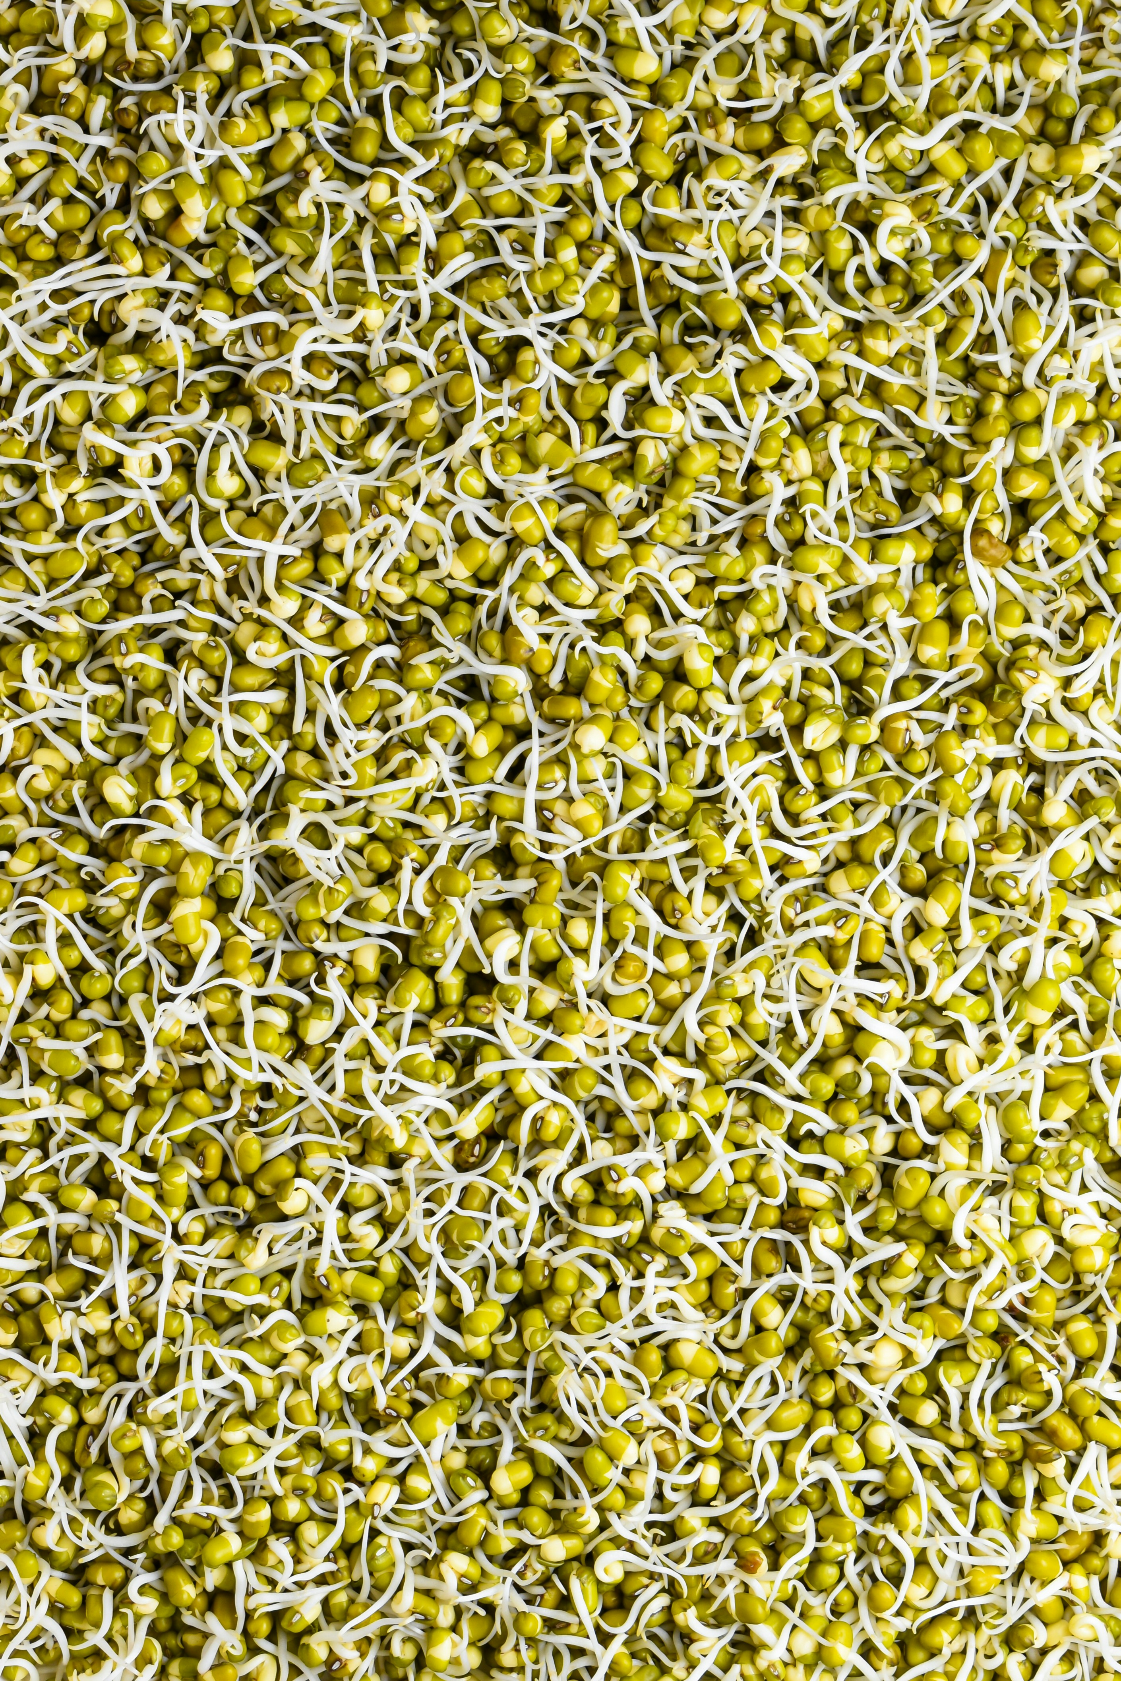

Micro herbs, Sprouting,
Edible flowers
Developed by Sustainable Kitchen Consultants Ltd for LBBD 2024

Slide 2
Why micro herbs, sprouting, edible flowers?
Science of biology & nature
Connection with nature
Connection and affiliation with farmers / agriculture
Reminder of food being ‘alive’ and nourishing us
Diversity of ingredients
Nutrition
Self sufficiency & resourcefulness
Developed by Sustainable Kitchen Consultants Ltd for LBBD 2024
Notes:
Hands-On Science Education
Biology Basics: Sprouting seeds and growing micro herbs is a simple, practical way to introduce young students to plant biology, including concepts like germination, photosynthesis, and life cycles.
Observation Skills: Watching seeds sprout and grow allows students to observe and document changes, helping them develop critical observation and data-recording skills.
Scientific Inquiry: They can ask questions, make predictions, and test hypotheses in a hands-on setting, encouraging scientific thinking from a young age.
Connection to the Community and Economy
Farm-to-Table Connections: By learning to grow their own food, students start to understand the role of farmers, markets, and food production in the community.
Teaching children about plants fosters a sense of respect for nature and can introduce broader concepts like ecosystems, sustainability, and the importance of plant life on Earth.

Slide 3
Sprouting
Developed by Sustainable Kitchen Consultants Ltd for LBBD 2024
Notes:
Plus also show students different varieties of lentils, beans, etc. Get them to feel them.

Slide 4
What is sprouting, in cooking practices?
In culinary terms, sprouting refers to the process of germinating seeds, grains, or legumes until they produce young shoots or sprouts.
This process often involves soaking the seeds or grains in water for a period of time, typically several hours to overnight, and then allowing them to germinate in a warm, moist environment.
Sprouting can enhance the nutritional value of certain foods, making them easier to digest and increasing their vitamin and mineral content
Sprouting can also prolong the life of ingredients, which is good for reducing food waste
Sprouts are commonly used in salads, sandwiches, stir-fries, and other dishes to add flavour, texture, and nutritional value. Popular sprouts include alfalfa, mung bean, lentil, and broccoli sprouts
Developed by Sustainable Kitchen Consultants Ltd for LBBD 2024
Notes:
When seeds like lentils and quinoa are exposed to water, the seed absorbs it through a process called imbibition. This triggers metabolic changes inside the seed.Water activates enzymes such as amylase, protease, and lipase. These enzymes start breaking down the seed's stored nutrients (carbohydrates, proteins, and fats) into simpler molecules that the young plant can use for growth.

Slide 5
Sprouting – Human health benefits?
Sprouts are one of the most alive and nourishing foods we can eat. Once sprouted:
  Grains, seeds and beans have 15% – 30% more protein than their unsprouted versions
  Up to 10 times the B-vitamins, more vitamin C, vitamin E and K, beta-carotene, calcium, phosphorus and iron
  Radish sprouts contain 29 times more vitamin C than milk, 10 times more calcium than a potato and more vitamin C than a pineapple
  Mung beans and lentils have almost no vitamin C, yet their sprouts have a considerable amount
Developed by Sustainable Kitchen Consultants Ltd for LBBD 2024
Notes:
Source: https://sproutnet.com/health-benefits-of-sprouts/

Slide 6
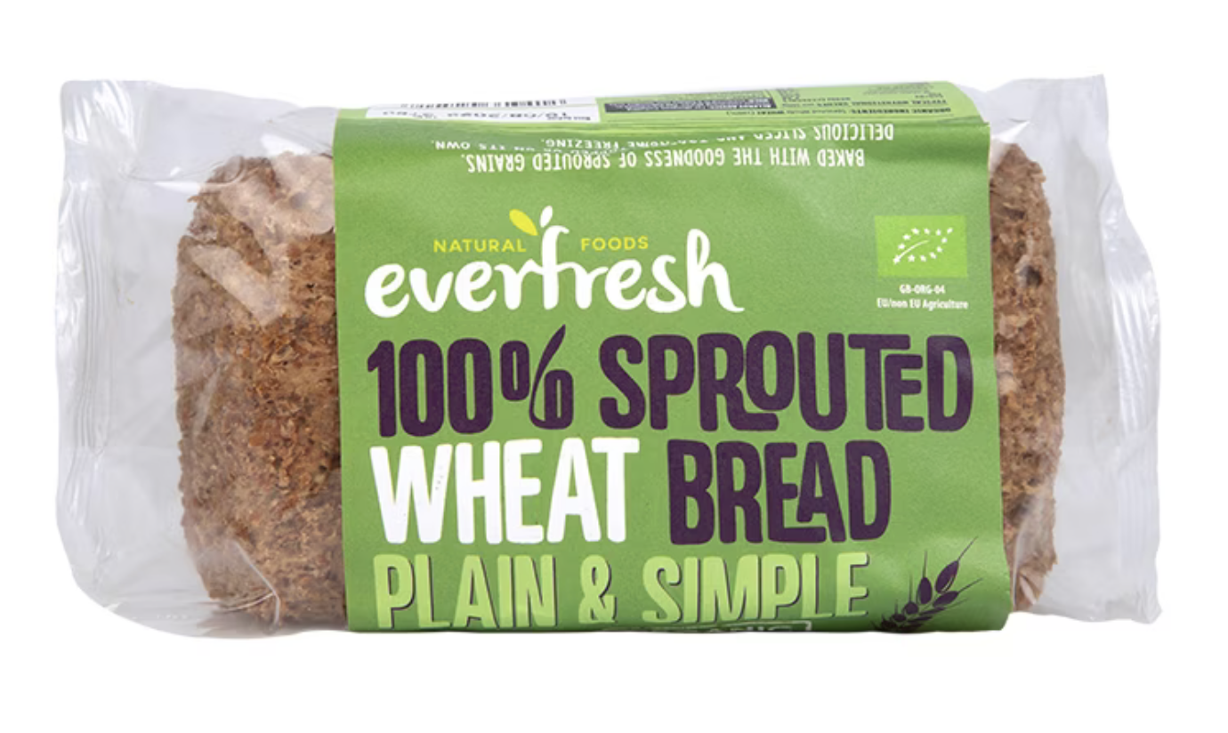
Sprouting – Human health benefits?
Wheat: Because gluten (a protein in wheat) is broken down during sprouting, many individuals with wheat sensitivities “may” be able to eat sprouted wheat based breads.
Beans: Sprouting reduces gas-producing quality of beans.
Developed by Sustainable Kitchen Consultants Ltd for LBBD 2024
Notes:
Many food products now available with sprouted flours, for e.g. these provide nutrient dense additions to diets.

Slide 7
Sprouting – How is it done?
Soak the grain, bean or seed in water in a glass jar. Make sure the water is double the amount of what you’re soaking, because it will expand once it absorbs the water
Leave the jar on at room temperature for the specified time (depending on what you’re sprouting). You may need to drain the water and change it to fresh water once or twice, for things that require long soak times
Drain the liquid, then rinse and fill back up with fresh water. Drain the liquid slowly at an angle to create a humid environment. Your goal is to keep the kernels moist until they sprout a bud. They do this by being exposed to light and moisture.
Repeat Step 3 every few hours, or at least twice daily. In 1-4 days, your sprouted produce should be ready. Do a final rinse of the sprouts, and discard hard seeds that didn’t sprout
Use / Eat within 2-3 days. You can put them on salads, sandwiches, in smoothies or soups and stews
Sprouts can be dehydrated and ground into flour for baking
Developed by Sustainable Kitchen Consultants Ltd for LBBD 2024

Slide 8
Sprouted beans – Cooking method
Sprouted beans can be eaten raw or cooked, depending on personal preference and the specific recipe.
Raw sprouted beans can be added to salads, sandwiches, wraps, or consumed as a snack. They provide a crunchy texture and fresh flavour.
Cooked sprouted beans can also be used in various dishes such as soups, stir-fries, curries, or casseroles. Cooking sprouted beans can soften them further and make them more digestible.
However, because sprouted beans are already partially germinated, they typically require less cooking time compared to unsprouted beans.
Overcooking sprouted beans may result in mushiness and loss of texture, as well as loss of nutrients, so it's important to monitor them closely while cooking
Developed by Sustainable Kitchen Consultants Ltd for LBBD 2024

Slide 9
Sprouted foods – World cuisine
Sprouting is a culinary practice that has been practiced for centuries, so is found in various world cuisines, often as part of traditional and health-conscious diet. Some examples include:
Indian Cuisine: Sprouting is commonly practiced in Indian cuisine, where it's known as "dal sprouts" or "pulse sprouts." Lentils, mung beans, and other pulses are often sprouted and used in dishes like salads, curries, and snacks. One popular Indian dish featuring sprouted beans is "moong dal salad" or "sprouted mung bean salad.”
Asian Cuisines: Several Asian cuisines, including Chinese, Thai, and Vietnamese, incorporate sprouts into their dishes. Bean sprouts, such as mung bean sprouts, are commonly used in stir-fries, soups, spring rolls, and noodle dishes.
Middle Eastern Cuisine: Sprouting is also prevalent in Middle Eastern cuisine, particularly in dishes like tabbouleh, where sprouted grains like wheat or bulgur are mixed with parsley, mint, and vegetables.
Developed by Sustainable Kitchen Consultants Ltd for LBBD 2024

Slide 10
Sprouted foods – World cuisine
Korean Cuisine: sprouts are frequently used in dishes such as bibimbap (a mixed rice dish), kongnamul bap (sprouted soybean rice), and various types of soups and stews. Soybean sprouts (kongnamul) and mung bean sprouts (sukjunamul) are particularly popular.
Ethiopian Cuisine: sprouted grains like teff, barley, and wheat are used in traditional dishes such as injera (a sourdough flatbread) and tef firfir (a savoury dish made with torn injera mixed with other ingredients). Sprouted lentils and chickpeas are also common additions to salads and stews
Latin American Cuisine: sprouts are used in a range of dishes. For example, in Mexican cuisine, sprouted beans or lentils might be used in salads or as a topping for tacos. In Peruvian cuisine, sprouted grains like quinoa or kiwicha are used in salads, soups, and other dishes
Italian Cuisine: While not as common sprouted grains like wheat or barley can be found in traditional Italian dishes, such as salads or mixed into pasta for added texture and nutrition.
Eastern European Cuisine: In countries like Russia, Ukraine, and Poland, sprouted grains are sometimes used in salads, soups, and porridges, especially during Orthodox Christian fasting periods when abstaining from animal products
Developed by Sustainable Kitchen Consultants Ltd for LBBD 2024

Slide 11
Micro herbs
Developed by Sustainable Kitchen Consultants Ltd for LBBD 2024

Slide 12
Micro greens - Nutrition
Higher Nutrient Density
More vitamins, minerals, and antioxidants per gram compared to fully grown versions of the same plants. For example:
Vitamins: Higher levels of vitamins C, E, and K than mature plants. Essential for immune function, skin health, and blood clotting.
Minerals: Microgreens are also richer in essential minerals like potassium, iron, zinc, magnesium, and copper.
Antioxidants: Antioxidants, including polyphenols and other compounds, are more concentrated in microgreens. Antioxidants help reduce oxidative stress in the body, which is linked to aging and disease.
Developed by Sustainable Kitchen Consultants Ltd for LBBD 2024

Slide 13
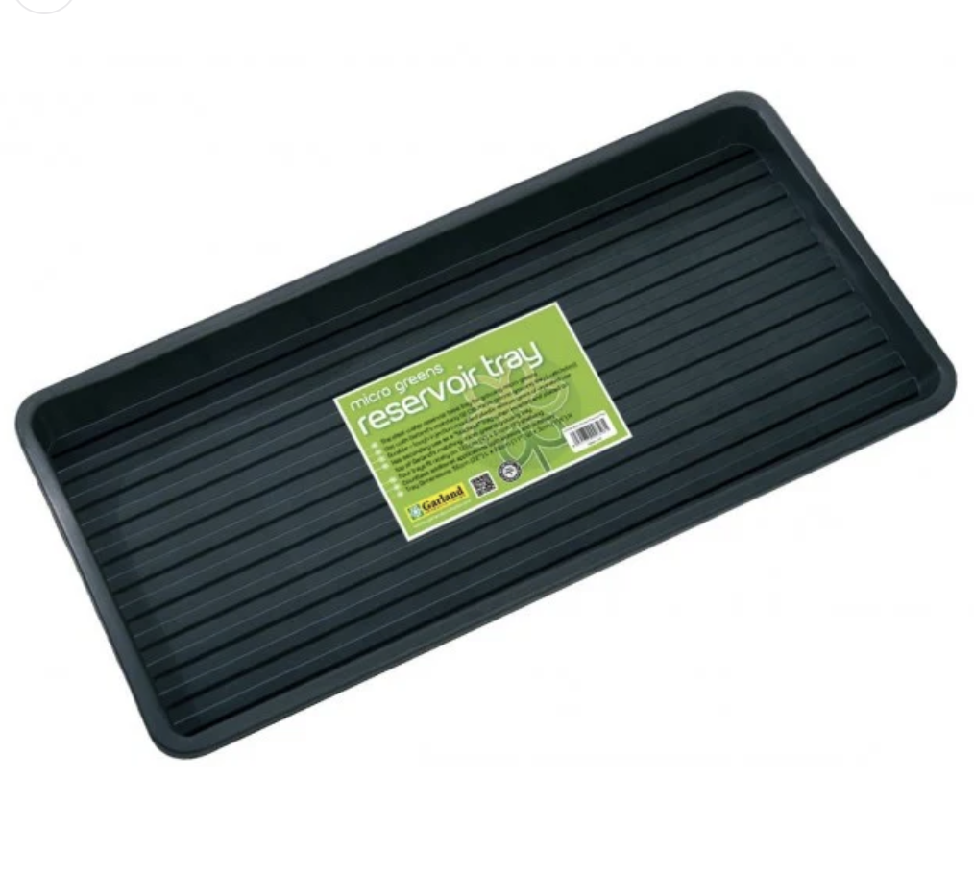
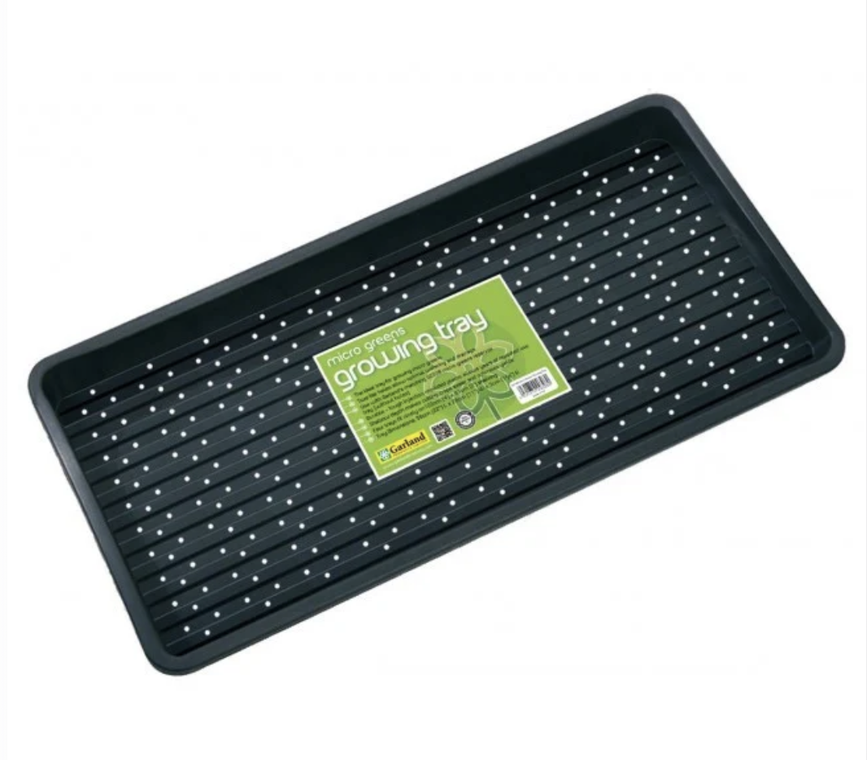
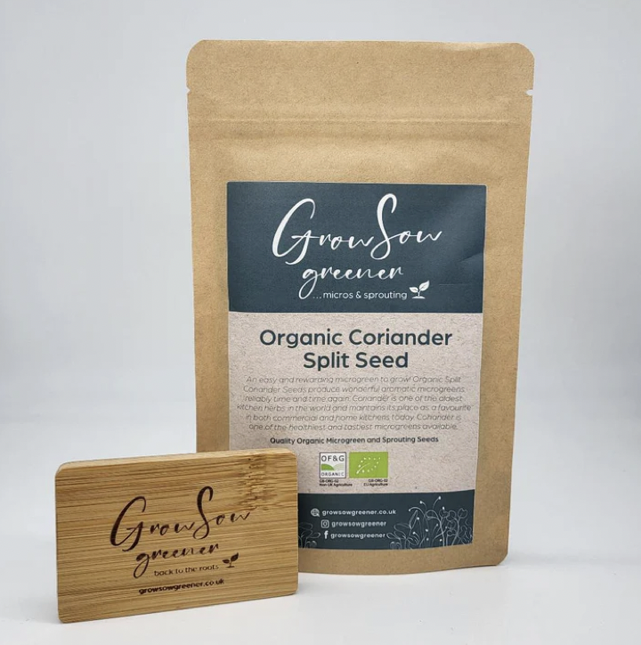
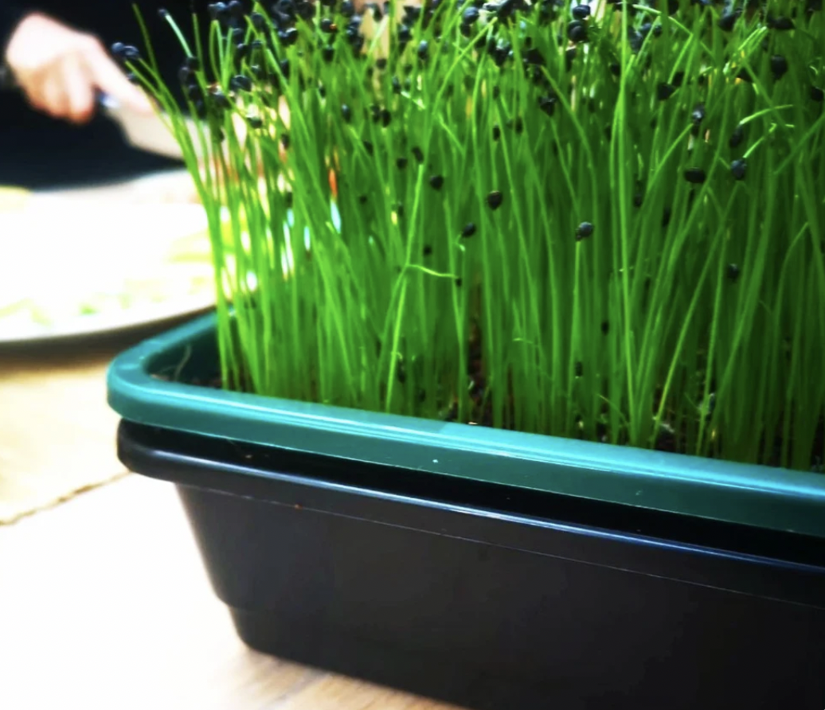
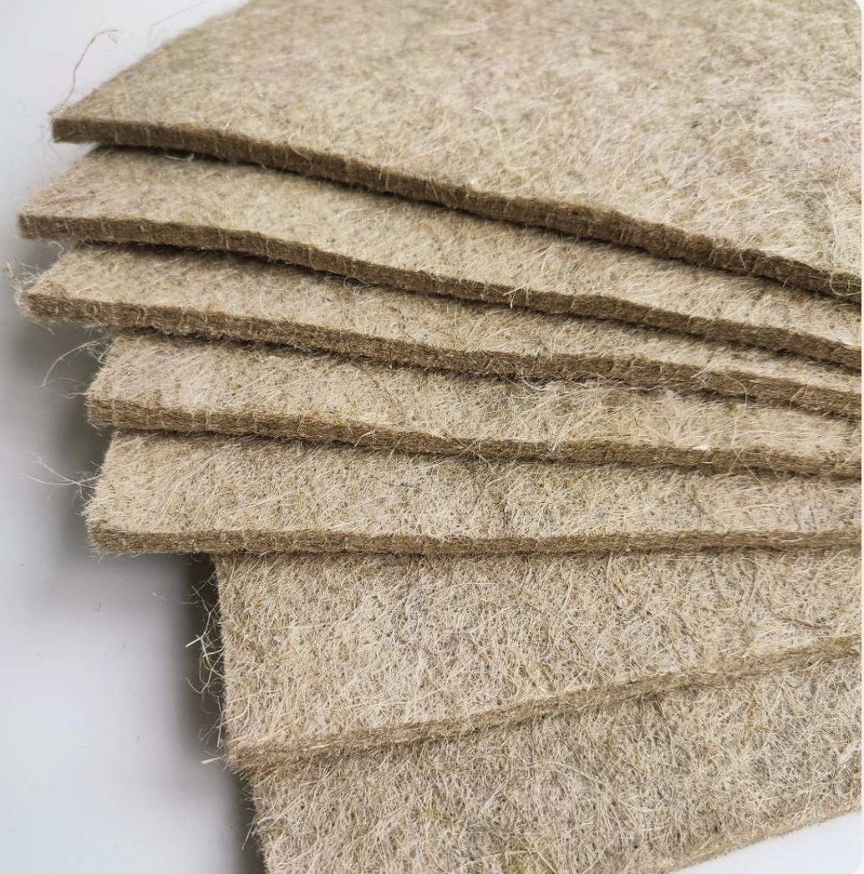
Growing micro herbs
Outer tray
Inner tray – with holes
Seeds
Inner tray – with holes (Hemp, UK)
Developed by Sustainable Kitchen Consultants Ltd for LBBD 2024
Notes:
Can also use – cotton wool, or cloth or paper towel, so no need to spend a lot of money

Slide 14



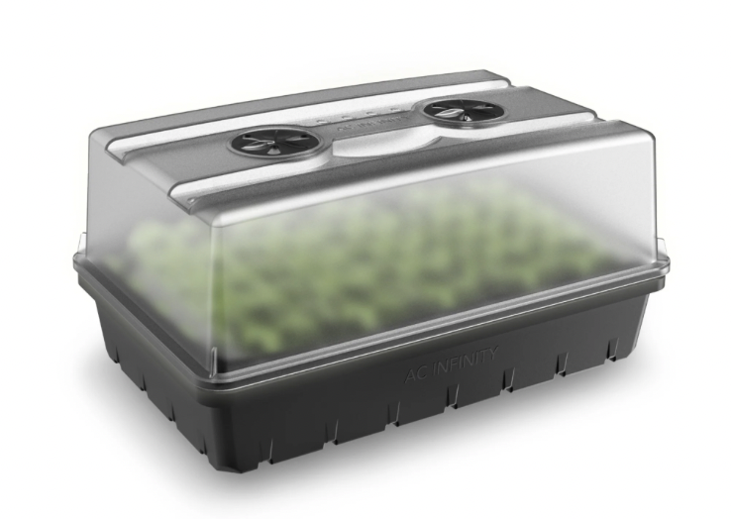
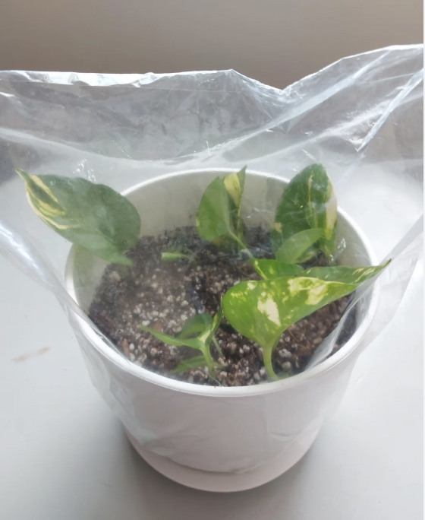
Growing micro herbs
Sunlight
Water mister
Grow lights
Dome cover
Developed by Sustainable Kitchen Consultants Ltd for LBBD 2024

Slide 15
Micro greens
Prepare the Growing Trays
Fill the Tray: Add a 1-2 inch layer of the growing medium, spreading it evenly. Lightly press down to create a flat, even surface.
Moisten the Soil: Use a spray bottle to lightly mist the soil. The soil should be damp but not soggy.
Sow the Seeds
Spread the Seeds: Scatter seeds evenly over the soil. Microgreens are typically sown densely, so aim for good coverage without overcrowding.
Cover the Seeds: Lightly press the seeds into the soil using your hands. You can also sprinkle a thin layer of soil on top if needed.
Mist Again: Lightly spray the seeds after sowing to ensure they’re settled and have enough moisture to start germinating.
Cover and Germinate
Cover the Tray: Use a plastic dome, bag, or even a piece of cardboard to cover the tray and retain moisture. Keep the tray in a warm, dark place for the first few days to encourage germination.
Developed by Sustainable Kitchen Consultants Ltd for LBBD 2024

Slide 16
Micro greens
Check Daily: Lift the cover daily to check moisture levels. Mist the soil as needed to keep it damp.
Provide Light and Water
Move to Light: Once the seeds start to sprout (usually within 2-7 days), move the tray to a bright spot or under grow lights. If using grow lights, keep them about 6-12 inches above the plants and run them for about 12-16 hours a day.
Bottom Watering: To avoid disturbing the seedlings, you can water from the bottom by adding water to a second tray and placing the microgreen tray on top for a few minutes. This lets the soil soak up moisture without washing away seeds or roots.
Harvesting
Microgreens are typically ready to harvest when they reach 1-3 inches tall and have developed their first true leaves (about 1-3 weeks, depending on the variety).
Harvest with Scissors: Use clean scissors to snip the greens just above the soil line.
Rinse and Store: After harvesting, rinse the greens gently and pat them dry. Microgreens can be stored in a sealed container in the fridge for up to a week.
Developed by Sustainable Kitchen Consultants Ltd for LBBD 2024

Slide 17
Micro greens – Growing time
Micro Cress: 2-3 days
Cress is one of the fastest-germinating microgreens, often showing sprouts within 48 hours.
Micro Rocket: 2-3 days
Arugula or rocket microgreens germinate very quickly and can start sprouting within 2 days under optimal conditions.
Pea Shoots: 2-4 days
Pea shoots germinate quickly, often sprouting within 2-3 days, especially if the seeds are soaked in water for 8-12 hours before planting.
Micro Basil: 5-7 days
Basil is slightly slower to germinate compared to other microgreens and prefers warmth for optimal germination.
Micro Coriander: 7-10 days
Coriander seeds take longer to germinate due to their hard outer shell. Splitting or crushing the seeds gently before sowing can speed up germination.
Developed by Sustainable Kitchen Consultants Ltd for LBBD 2024

Slide 18
Micro cress
Days 1-3: Seeds are sown and start to germinate quickly, often sprouting within the first 24–48 hours.
Days 4-7: Rapid growth as the seed leaves (cotyledons) expand, giving the micro cress its recognisable shape.
Days 8-14: The first true leaves start to form, and the micro cress reaches its peak flavour, size, and nutrient density.
Developed by Sustainable Kitchen Consultants Ltd for LBBD 2024

Slide 19
Pea shoots
Days 1–3: The pea seeds begin to germinate after being soaked, with tiny roots and shoots emerging.
Days 4–7: Rapid growth takes place as the initial leaves (cotyledons) and stems develop. By the end of this week, you’ll see small shoots forming.
Days 10–14: The pea shoots reach an ideal height of around 3–5 inches, with tender stems and small leaves, making this a common harvest stage for young, delicate shoots.
Days 15–21: The shoots grow taller and may produce tendrils and slightly larger leaves. Pea shoots harvested at this stage are a bit more substantial and have a slightly stronger flavour, which some consumers prefer.
Developed by Sustainable Kitchen Consultants Ltd for LBBD 2024

Slide 20
Troubleshooting
Mould or fungal growth
Too much water or Poor ventilation
Natural antifungal spray: Dilute a small amount of hydrogen peroxide (3%) in water and mist the surface lightly to reduce mould. Chamomile tea (cooled) can also help prevent fungal issues.
Yellowing Leaves
Too little light or overwatering
Slow or Stunted Growth
Low temperature – ideally you want the temperature to be between 18 – 24 degrees C
Developed by Sustainable Kitchen Consultants Ltd for LBBD 2024

Slide 21
Micro greens – Culinary inspiration
Salads: mix them with other greens for a fresh, nutrient-rich salad.
Soups: Garnish hot or cold soups with microgreens right before serving to add colour, freshness, and a burst of flavour.
Plated Dishes: Sprinkle microgreens over plated dishes to elevate nutrition, presentation and flavour.
Topping for Sandwiches and Wraps: Add a unique texture and taste to sandwiches, wraps, and burgers.
Breakfast Toasts: Add microgreens to avocado toast, ricotta, or hummus-topped toast for extra nutrients and colour.
Smoothies and Juices Toss a handful of mild-flavoured microgreens, like micro spinach or kale, into smoothies for a nutrient boost without altering the flavour too much.
Flavour Enhancers: Use in pasta, pizza, or Italian dishes as a garnish or blend into pesto for an intense flavour.
Developed by Sustainable Kitchen Consultants Ltd for LBBD 2024

Slide 22
Micro greens – Culinary inspiration
Egg Dishes Add to scrambled eggs, omelettes, or frittatas just before serving.
In Rice and Grain Bowls
Use microgreens as a topping for grain bowls, like quinoa or brown rice, along with other vegetables and proteins. They add a fresh crunch and burst of flavour.
Infusing Flavoured Oils and Butters
Blend microgreens like micro basil or micro chives into softened butter for a unique, flavoured spread.
Microgreen Pesto: Substitute regular greens with micro basil or micro rocket to make a vibrant pesto sauce for pasta, bread, or grilled vegetables.
Microgreens in Baking and Pastries
Add microgreens like micro mint or micro basil into savoury pastries, bread, or even incorporate them into doughs for colour and unique flavour.
Developed by Sustainable Kitchen Consultants Ltd for LBBD 2024

Slide 23
Edible flowers
Developed by Sustainable Kitchen Consultants Ltd for LBBD 2024
Notes:
See recipes
Plus also show students different varieties of lentils, beans, etc. Get them to feel them.

Slide 24
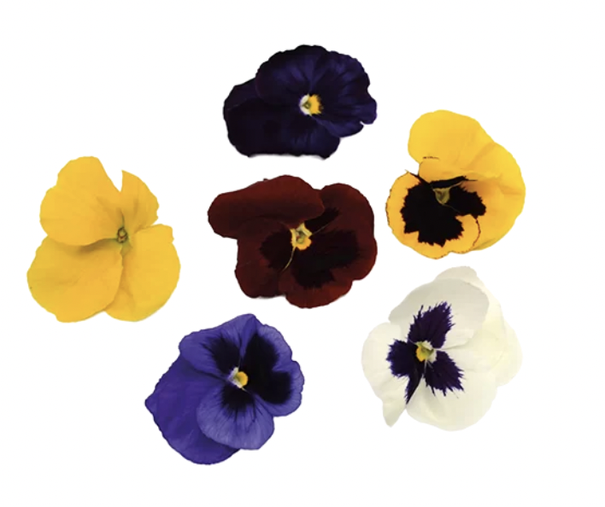
Violas
Violas generally have a growing time of about 8-12 weeks from seed to bloom indoors
Germination -1-2 Weeks
Seedling Growth 3-4 Weeks
Mature Plant and Bud Formation 4-6 Weeks
Flowers blooming Begins at c 8 Weeks
Developed by Sustainable Kitchen Consultants Ltd for LBBD 2024

Slide 25
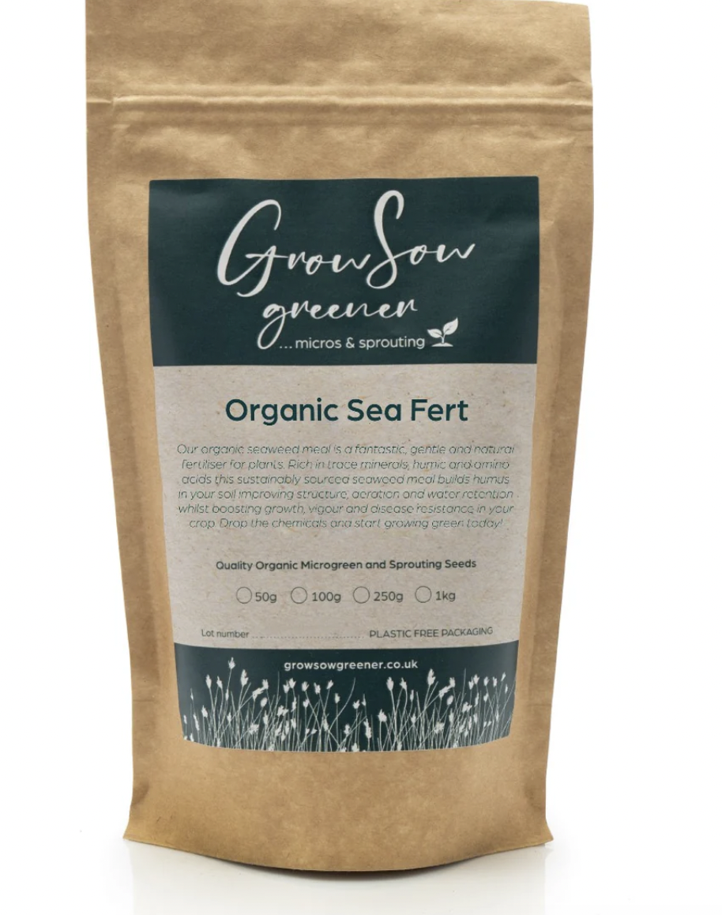
Violas
Viola seeds
Containers: Pots with drainage holes (10-15 cm deep)
Soil mix: A light, well-draining, organic soil mix
Fertiliser: Seaweed or Epsom salts is natural version
Watering can or spray bottle
Light (optional, if your windowsill doesn’t get enough light)
Developed by Sustainable Kitchen Consultants Ltd for LBBD 2024

Slide 26
Violas
Light: They need about 4-6 hours of light per day. If your windowsill doesn't get enough sunlight, consider using a grow light for 10-12 hours a day.
Temperature: Violas thrive in cooler temperatures, ideally 13-21°C. Avoid placing them in hot areas, such as directly in front of a heater or air conditioner.
Drainage: Ensure your container has drainage holes at the bottom to prevent water from pooling, which can lead to root rot.
Watering: Water regularly, but only when the top 2.5 cm of soil feels dry. Violas don’t like their roots sitting in water, so ensure the pot has good drainage. Avoid Overwatering Let the soil dry slightly between waterings to prevent root rot.
Air Circulation: Ensure there’s good air circulation around the plants to prevent fungal diseases. If possible, rotate the pots every few days to ensure even growth.
Developed by Sustainable Kitchen Consultants Ltd for LBBD 2024

Slide 27
Violas
Fertiliser Once your violas have started growing well (typically after 3-4 weeks), feed them once a month with a natural fertiliser
Removing dead flowers or buds Regularly remove any spent flowers to encourage new blooms. Pinch off flowers that are past their prime to keep the plant looking neat and encourage more blossoms.
Yellow Leaves If the leaves are turning yellow, it could be a sign of overwatering or nutrient deficiency. Adjust watering and check if the plant needs fertiliser.
Pests Check for pests like aphids or spider mites. If you spot any, use a mild soap solution or neem oil to treat the plant.
1 tablespoon of mild liquid dish soap (preferably unscented and without degreasers or additives) 1 litre of water
Developed by Sustainable Kitchen Consultants Ltd for LBBD 2024

Slide 28
Thank you
Developed by Sustainable Kitchen Consultants Ltd for LBBD 2024

