Slide 1
Barking & Dagenham
Business Support Directory
2024 Edition

Slide 2
Introduction
This guide brings together the different programmes of support, training and workspace that is available for organisations in the borough.
Whether you’re a start up, looking to grow or expand your business this guide will hopefully help you to find the support that you're looking for.
If you would like to discuss or meet with the team to discuss your support needs you can email us at businessforum@lbbd.gov.uk

Slide 3
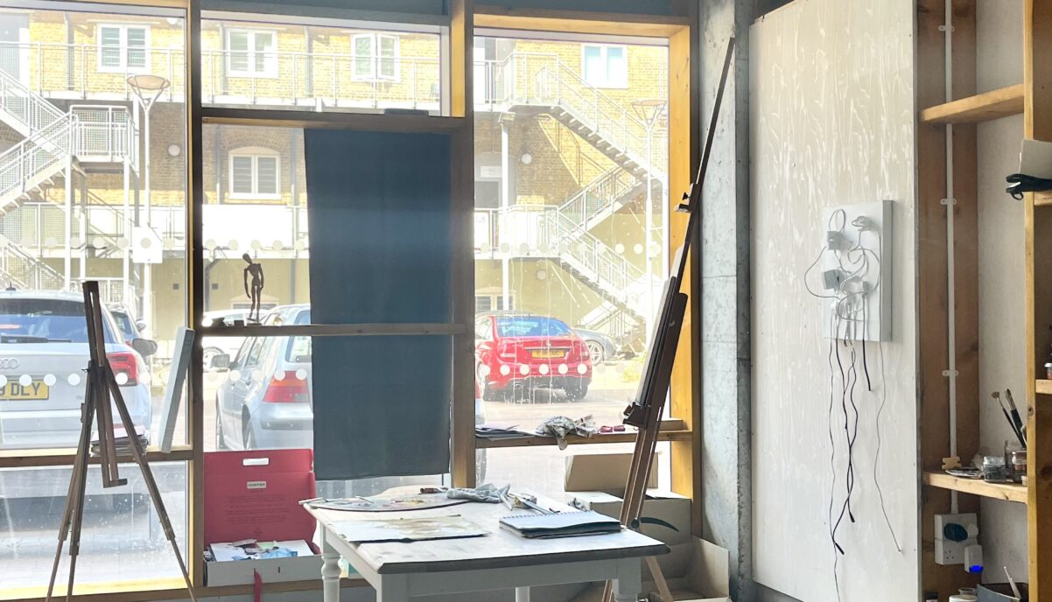
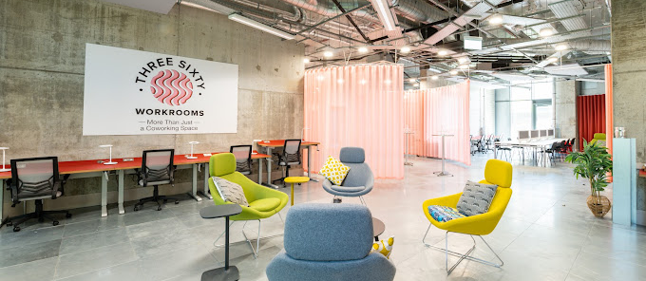
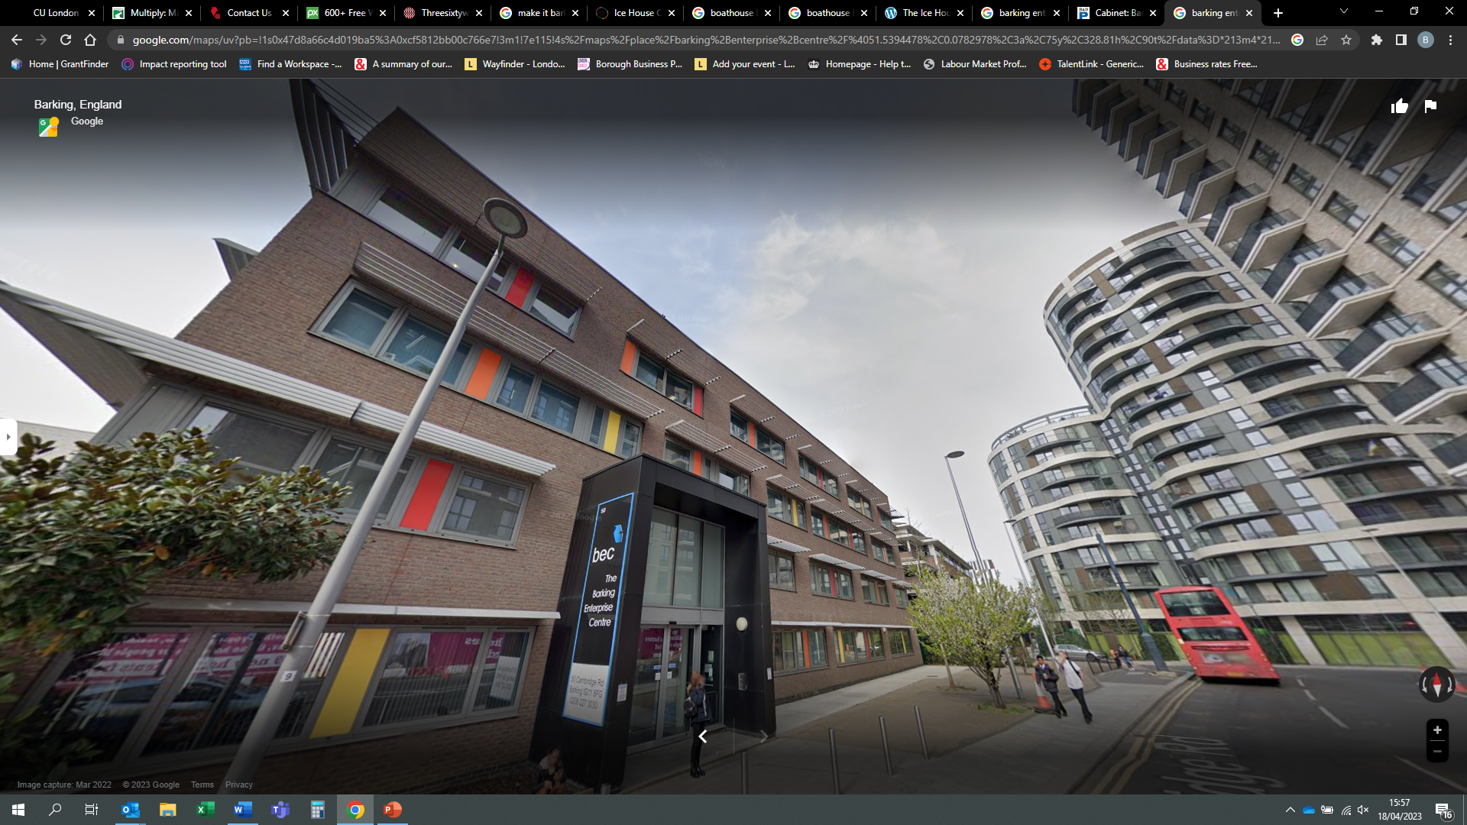
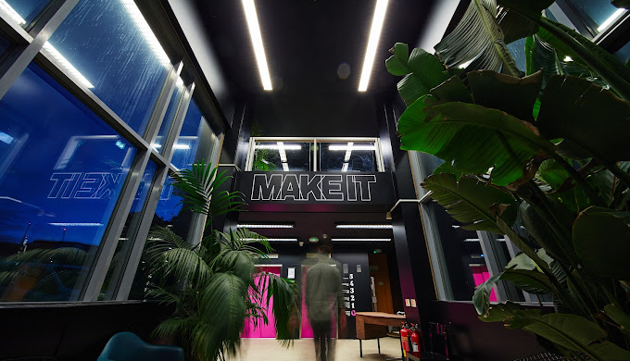

Slide 4
Workspace providers
Name and address of workspace | Brief description of types of spaces available & prices | Summary of services offered to businesses | Contact website, email & telephone | Any other relevant info
Barking Enterprise Centre 50 Cambridge Road Barking IG11 8FG | 48 low cost serviced office units for sole traders and teams of up to six people. Step free access. | Free 121 mentoring and training available for all local businesses. As well as offering a large suit of webinars and workshops of a variety of business topics | www.beccic.co.uk reception@barkingenterprisecentre.co.uk 020 8227 3030 020 8227 5037 | Offers flexible options from hotdesking, office spaces to hiring out venue for meetings or conferences
BEC 2 50 Wakering Rd Barking IG11 8GN | 26 professional and affordable workspaces, meeting rooms and a recording studio in Barking town centre, including a collective of arts-focused businesses. Step free access. | Free 121 mentoring and training available for all local businesses | www.beccic.co.uk reception@barkingenterprisecentre.co.uk 020 8227 3030 020 8227 5037
Three-Sixty Workrooms Cambridge Road Barking IG11 8FG | Co-working space for social sector businesses, freelancers, creators, influencers and other professionals in Barking town centre, with flexible and affordable membership options. Step free access. | Free 121 mentoring and training available for all local businesses. | www.threesixtyworkrooms.com reception@barkingenterprisecentre.co.uk 020 8227 3030 020 8227 5037 | Walk-in-Wednesday offer: If you want to give the space a trial use now you can on any Wednesday of your choice!
Make It Barking 15 Linton Rd Barking IG11 8HE | 5-story block of office units, co-working desk space and meeting rooms in Barking town centre - with a bar, events spaces, fitness and wellness studio, and photography and film studio. Step free access. | Peer-to-peer business support is available for tenants. Discounts are available when hiring rooms for events with a social purpose. | https://www.makeitlondon.co.uk/barking Info@makeitlondon.co.uk 020 3745 1565 https://www.instagram.com/factory15barking | A limited number of Future Enterprise spaces are available at extra reduced rent for businesses and social sector enterprises who are shaping a better future for us all. Applications open every summer.
Riverside Mills – Bow Arts Commercial Unit 1 42 Abbey Road Barking IG11 7RU | Affordable studios for artists, makers and designers with step free access. Ave £/sq ft £12 inclusive | Workshops, training sessions, panel discussions and the sale of your art through Own Art | https://www.bowarts.org/location/riverside-mills/

Slide 5
Workspace providers
Name and address of workspace | Brief description of types of spaces available & prices | Summary of services offered to businesses | Contact website, email & telephone Any other relevant info
Icehouse Court Studios – Bow Arts Units 1-11, 56 Abbey Rd Barking IG11 7FR | Affordable studios for makers, artists and designers with step free access. Ave £/sq ft £12 inclusive | Workshops, training sessions, panel discussions and the sale of your own art | https://www.bowarts.org/location/ice-house-court/
The Boathouse Creative Studios 62-76 Abbey Road Barking, IG11 7BT | Studio space available to hire for rehearsals, workshops and events | An unusual and quirky riverside multi-purpose venue offering four flexible studios for a variety of business, corporate and private celebration events. | www.boathousebarking.co.uk admin@boathousecic.co.uk 020 8594 0039
Barking and Dagenham Council – Commercial Property | Commercial units and spaces to let in various locations across the borough. Including Dagenham Heathway Shopping Centre |  | https://www.lbbd.gov.uk/business/commercial-property
London East UK | Business, science and technology park at Dagenham East – offering specialist lab space as well as office and warehousing. | Fully serviced laboratories, offices and conference space with an onsite café and catering service | https://www.londoneast-uk.com/
Industria | Industrial units in a pioneering multi-story scheme in Barking. | The scheme provides 45 new industrial warehouse and creative space units with a café, co-working lounge, meeting rooms and external break out space designed to bring local businesses together.. | https://industriabarking.co.uk/
CEME Business Campus Marsh Way Rainham RM13 8EU | 19-acre campus bordering the borough with serviced offices, purpose-built workshop & engineering space. Short-term coworking spaces & virtual offices for start-up & growing businesses. Focus on engineering, technology & training businesses. | Free start-up and growth programme of events | www.ceme.co.uk/workspaces/ www.ceme.co.uk/business-growth-academy info@ceme.co.uk 020 8596 5400

Slide 6
Workspace providers
Name and address of workspace | Brief description of types of spaces available & prices | Summary of services offered to businesses | Contact website, email & telephone Any other relevant info
Vicarage Fields Shopping Centre | Short and long term retail space for hire in Barking town centre. | Shopping centre located in the heart of Barking Town Centre | office@vicfield.co.uk 020 8270 7100
CU London Dagenham Campus Rainham Road North Dagenham RM10 7BN | Hotdesking ,co-working space for businesses, freelancers, creators, influencers and other professionals in RM10. Step free access. Free Wi-Fi in our Union strEAT Kitchen. Training rooms available upon request. | Range of spaces available that are suited to anything from a business meeting to a conference. | https://www.coventry.ac.uk/cul/dagenham/ Charlotte.Mills@coventry.ac.uk 020 3873 0700
Barking and Dagenham College Rush Green Campus RM7 0XU | Conference Centre and other meeting rooms available to rent with plenty of parking space on site | Range of spaces available that are suited to anything from a business meeting to a wedding reception Users of our Rush Green spaces have access to our free visitors' parking. | Rush Green campus – 020 3667 0211 or 0745 802 3693 Barking campus – 020 3667 0501 commercialhire@bdc.ac.uk

Slide 7
General Business Support & Networks
Name of organisation | Summary of services offered to businesses | Current programmes that are taking place and aims of programme | How to sign up contact email & telephone / any useful info on programme
Barking Enterprise Centre | 121 mentoring support to help you develop your business. | Webinars on a range of topics from marketing to starting up your own business | www.beccic.co.uk/events 020 8227 3030 020 8227 5037 reception@barkingenterprisecentre.co.uk
Barking and Dagenham Chamber of Commerce | Local membership organisation that aims to promote trading, represent the interests of those doing business and to help enhance their economic success, with events and networking opportunities. |  | https://bdchamber.co.uk/
Grow Local London | Signposting service to help local businesses identify their needs and access relevant support in the borough and beyond. Offering 121 support with a dedicated business mentor |  | https://www.growlondonlocal.london/
E-Business Support Programme | Free bespoke 121 digital and technical advice and support to SMEs in Barking & Dagenham. Now offering a face-to-face service operating from Barking Library every Wednesday & Thursday – email us to book you free session. |  | E-Business@newham.ac.uk 020 8257 4204 www.newham.ac.uk/ebusiness
Barking and Dagenham College Rush Green Campus Dagenham Road Romford RM7 0XU | Student placement as part of industry All of our learners are available to support businesses as part of their Industry Placement which is a free service for businesses | Industry areas include; Construction, Engineering, Plumbing, Electrical, Health and Social Care, Early Years ,Creative, Digital, Hospitality, Business and Finance and much more | catherine.weissand@bdc.ac.uk 07458 023692 lynn.parsonage@bdc.ac.uk 07904 853586

Slide 8
General Business Support & Networks
Name of organisation | Summary of services offered to businesses | Current programmes that are taking place and aims of programme | How to sign up contact email & telephone / any useful info on programme
CU London Dagenham Campus Rainham Road North Dagenham RM10 7BN | Student placements are part of their degree. Students complete an assignment which has a placement attached. The placement hours are varied for each course and the placement provision must relate to the Learning Outcomes to allow the student to gain the best experience. Placement Officer coordinates the placements throughout the academic year to support businesses which can often lead into employment. Businesses that have voluntary positions for these courses are welcome to promote these on campus. Arrangements to be made through the Placement Officer | Degree courses with mandatory placement include: HSC Y1 and Y2, Primary Education & Teaching Studies Y1 and Y2, Public Health Y3. | Bev Prynn Placement Officer ac9394@coventry.ac.uk 07392 096268

Slide 10
Digital Skills & IT Support
Name of programme | Details of the courses/support offered to businesses | Name of delivery organisation | How to sign up contact email & telephone / any useful info on programme
Digital marketing workshops | Free webinars and workshops held on regular basis in person & online. From digital marketing, social media and how to generate more leads for your business | Barking Enterprise Centre | reception@barkingenterprisecentre.co.uk 020 8227 3030 020 8227 5037
e-Business Support Programme | Free bespoke 121 digital and technical advice and support to SMEs in Barking & Dagenham, Havering and Newham. Whether you are a complete novice wanting to learn how to use Microsoft Office more effectively or developing a stronger online presence, their business advisors and digital specialists are here to help you. | Newham College of Further Education | E-Business@newham.ac.uk Tel: 020 8257 4204
Digital First Steps | The Digital First Steps workshops are designed to introduce complete beginners to ICT and the digital world. Sessions are in person and FREE at college sites. Bespoke options include training on Excel, Word, PowerPoint to using smart devices and more, either online or in person at the college. | Adult College | 0208 270 4722 AdultCollegeEnquiries@lbbd.gov.uk www.adultcollegeenrol.lbbd.gov.uk/product-category/it-and-digital-skills/
Cyber security courses | The Cyber Security BSc (Hons) course is designed to produce high quality graduates who can contribute effectively in one of the highest growing sectors in the UK and meets the needs of your business | CU London | www.coventry.ac.uk/cul/course-structure/hnc-hnd-degree/cyber-security/ 020 3873 0700
Cloud computing courses | The Cloud Computing BSc (Hons) is a model for enabling on-demand access to a pool of computing resources, e.g. networks, servers, storage, applications, and services, that can be rapidly provisioned with minimal management effort or service provider interaction | CU London | www.coventry.ac.uk/cul/course-structure/hnc-hnd-degree/cloud-computing-bsc-hon 020 3873 0700
Computer Programming Cyber Security Data technician Smart Home Technician and more | A full range of entry level courses that support individual needs but also bespoke to the needs of a business. | Barking and Dagenham College Rush Green Campus | www.barkingdagenhamcollege.ac.uk/find/courses 020 8090 3020

Slide 12
Recruitment Support
Name of delivery organisation | Details of the support offered to businesses | How to sign up contact email & telephone
B&D Works (previously the Job Shop) | Free recruitment service run by Barking and Dagenham Council's job brokerage services to help employers access local talent, including support with job descriptions, advertising, recruitment events, filtering and preparing prepare candidates. Includes specialist teams in construction. | Employer Engagement Team vacancies@lbbd.gov.uk
Barking and Dagenham College | Support to secure trainees, apprentices and industry placements. The team can support you from advertising the vacancy to running recruitment days. As long as you are planning to use BDC as your training provider, recruitment service is completely free to you and the candidate. | Business Engagement Team 0207 3667 0333 employer.services@bdc.ac.uk.
CU London | Promote your vacancies with talented students and graduates directly, at no cost by registering with the Handshake online platform. | 02477 659 678 talentteam@coventry.ac.uk

Slide 14
Key council contacts
Service area | Support offered to businesses | How to get in touch
Business Forum | The Business Forum acts as the main port of call for organisations in the borough. Whether you are looking for the latest news about investment and development activity in Barking and Dagenham; information about forthcoming events, networking opportunities and new funding and business support initiatives; or insights about business growth, the best way to keep up to date is to join our mailing list. You can also contact the team for general enquiries and the team also offers 121 support. | businessforum@lbbd.gov.uk
Trading Standards | We provide advice for businesses based in the borough and enforce legislation covering the description, safety and pricing of goods and services. Our aims are to ensure a fair and safe trading environment, protect the interests of people in the borough and support legitimate businesses to grow. We do this by: investigating consumer complaints when criminal consumer protection laws may have been broken achieving compliance with statutory controls inspecting businesses and retail premises enforcing the law in relation to doorstep crime, rogue trading and age-restricted products (such as alcohol, cigarettes, knives and fireworks) preventing the supply of unsafe goods working with other agencies to tackle consumer protection problems | 020 8215 3000 tradingstandards@lbbd.gov.uk
Planning | Be First provide statutory planning services on behalf of the Council. They work to provide and industry best planning service to all customers through the publication of an up to date Local Plan supported by a robust evidence base and to provide a decision on all planning applications within statutory timeframes. | Visit the Council's website for more info here or contact planning@befirst.london
Licencing | Many businesses may require specialist licences, from food businesses (from home and business premises), street trading, fireworks, special treatment (personal beauty, massage etc.) We would encourage all organisations to get in touch with the team who can provide you with information and advice | Visit the Council's website for more information here

